Slide 1

Infectious Disease Spread Model
Karan Rajendra (115375145)
QianKun Nie (112111032)
Prof. Xiangmin Jiao
12/08/2023

Slide 2
Abstract 1. Introduction 2. Core Components of the Disease Spread Simulation 3. Parameters and Configuration 4. Individual Class 5. Population Class 6. Main simulation loop 7. Output 8. Visual Outputs 9. Conclusion

Slide 3
Introduction
An Overview of the Disease Spread Simulation
Project Overview:
This project involves the development of a simulation to model the spread of a disease within a population.
Utilizes object-oriented programming concepts to represent individuals and their interactions within a simulated environment.
Purpose of the Simulation:
To understand how different factors (like interaction rate, vaccination rate, etc.) influence the spread and containment of a disease.
To provide insights into the effectiveness of various public health interventions, such as vaccination strategies and lockdown measures.
High-Level Description of main.cpp:
main.cpp serves as the central control unit of the simulation.
It reads the simulation parameters from parameters.txt, initializes the population, and runs the simulation over a series of time steps.
Each time step involves updating the state of the population, applying potential interventions, and recording the simulation outcomes.
The results are saved to simulation_output.csv for analysis and visualization.
Visuals:
A schematic or conceptual diagram illustrating the overall structure of the simulation.
Snapshot of the main.cpp file or a relevant code segment.

Slide 4
Core Components of the Disease Spread Simulation 1. Main Program (disease.cpp): Role: Serves as the backbone of the simulation, orchestrating the overall process. Functions: Reads and interprets the simulation parameters from parameters.txt. Initializes the simulation environment, including the population. Manages the simulation loop, updating the state of the population at each time step. Records the simulation results into simulation_output.csv for subsequent analysis. 2. The Population Class: Role: Represents the collective group of individuals within the simulation. Functions: Manages a dynamic array of Individual objects, each representing a person in the simulated population. Handles the interactions between individuals, such as disease transmission, recovery, and vaccination. Provides aggregated data about the population's state (e.g., number of infected, recovered individuals). 3. The Individual Class: Role: Models the state and behavior of a single person in the population. Functions: Maintains personal attributes like health state (susceptible, infected, recovered, etc.), social activity level, and vaccination status. Responds to the simulation's environmental factors, such as infection risk and recovery chances. Can undergo state changes based on interactions and interventions within the simulation.

Slide 5
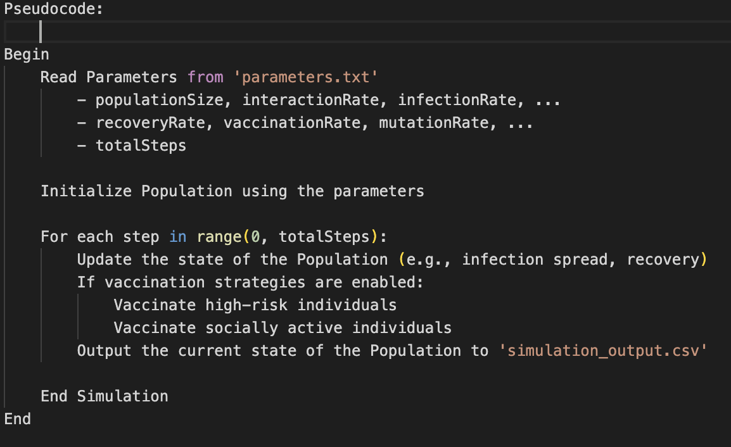
The Main Simulation Loop (main.cpp) Introduction to main.cpp: Acts as the central hub of the simulation, controlling the flow and execution of the entire process. Orchestrates the interactions between different components of the simulation. Flow of the Main Program: Reading Parameters: main.cpp starts by reading the simulation parameters from parameters.txt. These parameters include population size, infection rate, recovery rate, vaccination rate, and others, defining the simulation's initial conditions. Initializing the Population: With the read parameters, main.cpp initializes a Population object, creating a simulated environment. It sets up the initial state of each individual in the population (susceptible, infected, etc.). Running the Simulation Steps: The program enters a loop, running for the total number of steps defined in the parameters (totalSteps). In each step, it invokes the updatePopulationState method to simulate disease spread and recovery. If applicable, it applies specific strategies like vaccinateHighRisk or vaccinateSociallyActive. Outputting Results: After each step, main.cpp outputs the current state of the population to simulation_output.csv. This data includes the number of susceptible, infected, recovered, vaccinated, and dead individuals at each step.

Slide 6
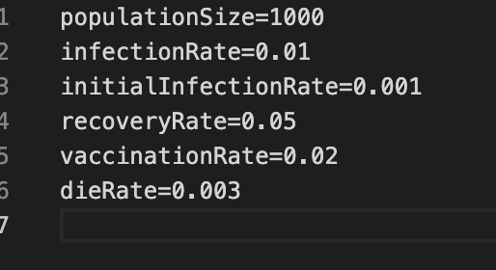
Parameters and Configuration Introduction to parameters.txt: The parameters.txt file sets critical parameters that guide the dynamics of the simulation. Each parameter plays a specific role in shaping the simulated epidemic. Details of Each Parameter Used: populationSize = 1000: This indicates the total number of individuals in the population being considered for the simulation. infectionRate = 0.01: This is the rate at which the disease spreads. It means that in each time step (day, week, etc., depending on the model), 1% of the susceptible (not yet infected) population will contract the disease. initialInfectionRate = 0.001: This suggests that initially, 0.1% of the population is infected. In a population of 1000, this would mean 1 individual is initially infected (0.001 x 1000 = 1). recoveryRate = 0.05: This is the rate at which infected individuals recover from the disease. In each time step, 5% of the currently infected population will recover. vaccinationRate = 0.02: This implies that 2% of the susceptible population is vaccinated against the disease in each time step. Vaccinated individuals are typically considered immune and no longer susceptible to infection. dieRate = 0.003: This is the mortality rate of the disease. It means that 0.3% of the currently infected population will die in each time step. Impact of Parameters on the Simulation: These parameters collectively determine how the disease outbreak unfolds and is managed within the simulation. Adjusting these values can simulate a wide range of epidemiological conditions and intervention strategies.

Slide 7
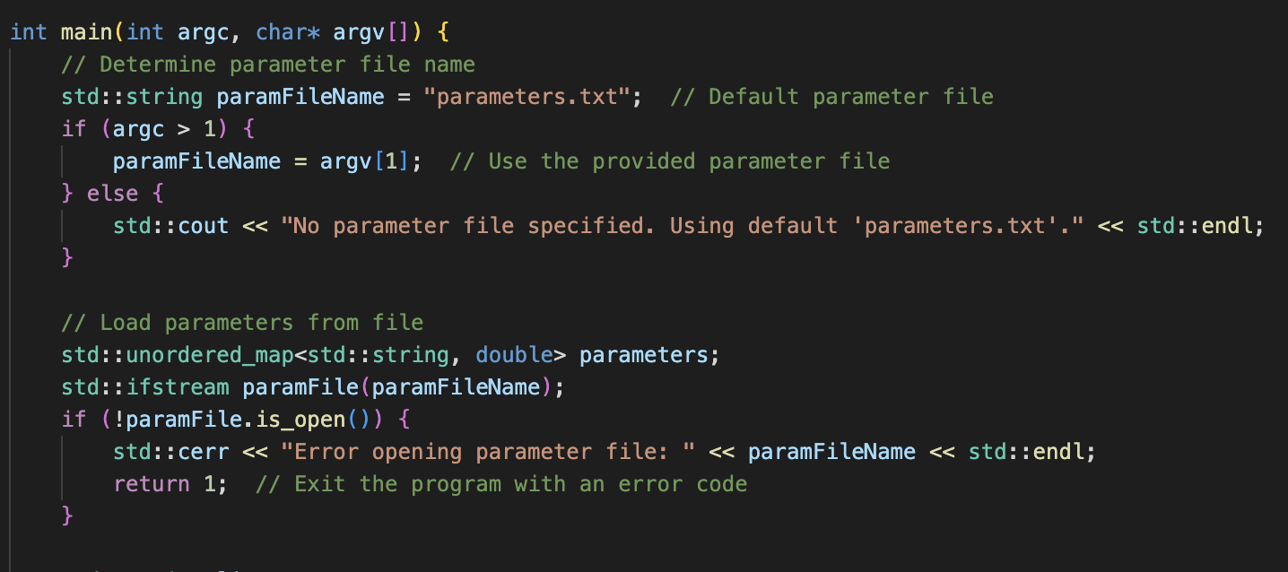
Testing Different Parameter Sets in the Simulation Introduction: The simulation program is designed to accept different parameter files through command line arguments. This feature allows for easy testing of various scenarios by changing parameters without altering the code. Steps to Test with Different Parameter Files: Prepare Multiple Parameter Files: Create various parameter files, each with a unique set of simulation parameters (e.g., parameters_set1.txt, parameters_set2.txt). Compile the Simulation Program: Makefile- to compile the project Run the Simulation with Different Parameter Files: Use the command line to run the simulation with each parameter file. ./main covid.txr, ./main lowinfection.txt, ./main longterm.txt

Slide 8
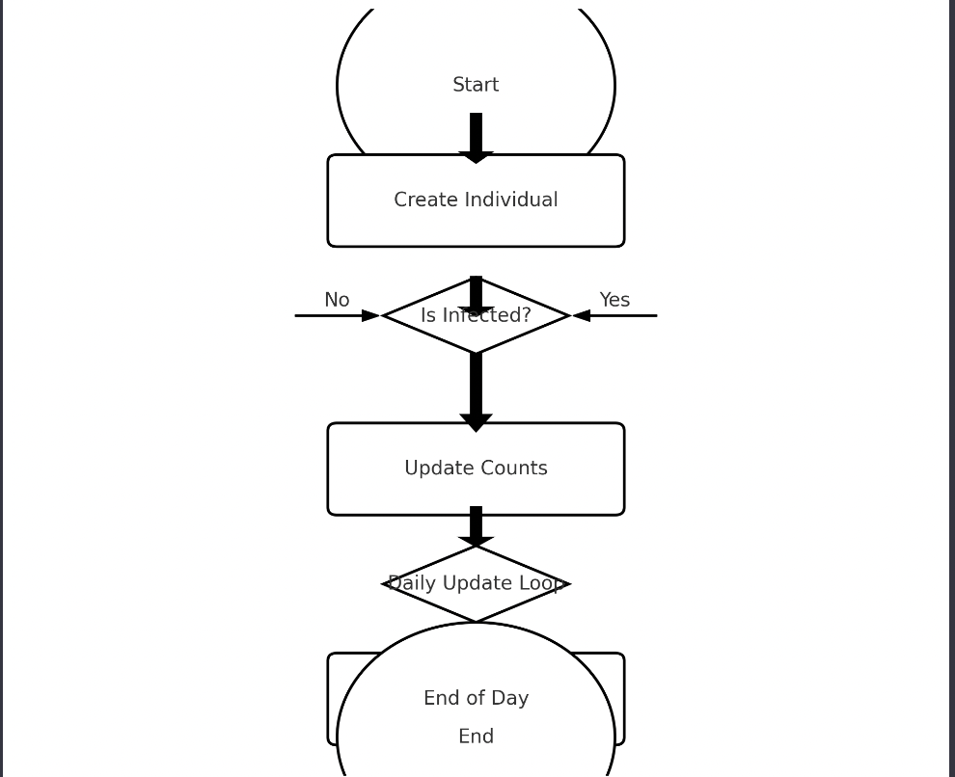
The Individual Class Introduction to the Individual Class: Purpose: Represents a single entity within a population in a disease simulation model. Functionality: Essential for simulating and tracking the behavior and status of each person as they interact with the disease and potential interventions. States of an Individual: Susceptible: Not infected but at risk of infection. Infected: Currently has the disease and can transmit it to others. Recovered: Has recovered from the infection and is no longer contagious. May or may not be susceptible to reinfection depending on the disease model. Vaccinated: Has received a vaccine and is presumed to have immunity against the disease. Dead: Has died due to the disease.

Slide 9
Key Methods and Their Functions: infection(double infectionRate, Individual &sick_individual): Updates the individual's state to Infected based on the infection rate and interaction with a sick individual. Accounts for the virus's mutation through the mutation_count attribute. recover(double recoveryRate): Changes an Infected individual's state to Recovered based on a given recovery rate. Updates the recover_level to represent immunity against certain levels of virus mutation. vaccinate(): Modifies the state of a Susceptible or Recovered individual to Vaccinated, simulating the effect of vaccination. Important for modeling the impact of vaccination campaigns on disease dynamics. die(): Transitions the state to Dead for an individual, affecting the counts of Infected and Died in the population. Additional Features: Social Activity Level: Each individual has a socialActivityLevel that determines the number of contacts they have, affecting the spread of the disease. Mutation Tracking: The mutation_count and mutation_time variables track the virus's mutation within an individual, impacting the infection and recovery processes. Travel and Source Tracking: The source variable indicates whether the individual is the original source of infection, and the travel() method simulates movement, potentially changing their source status.

Slide 10
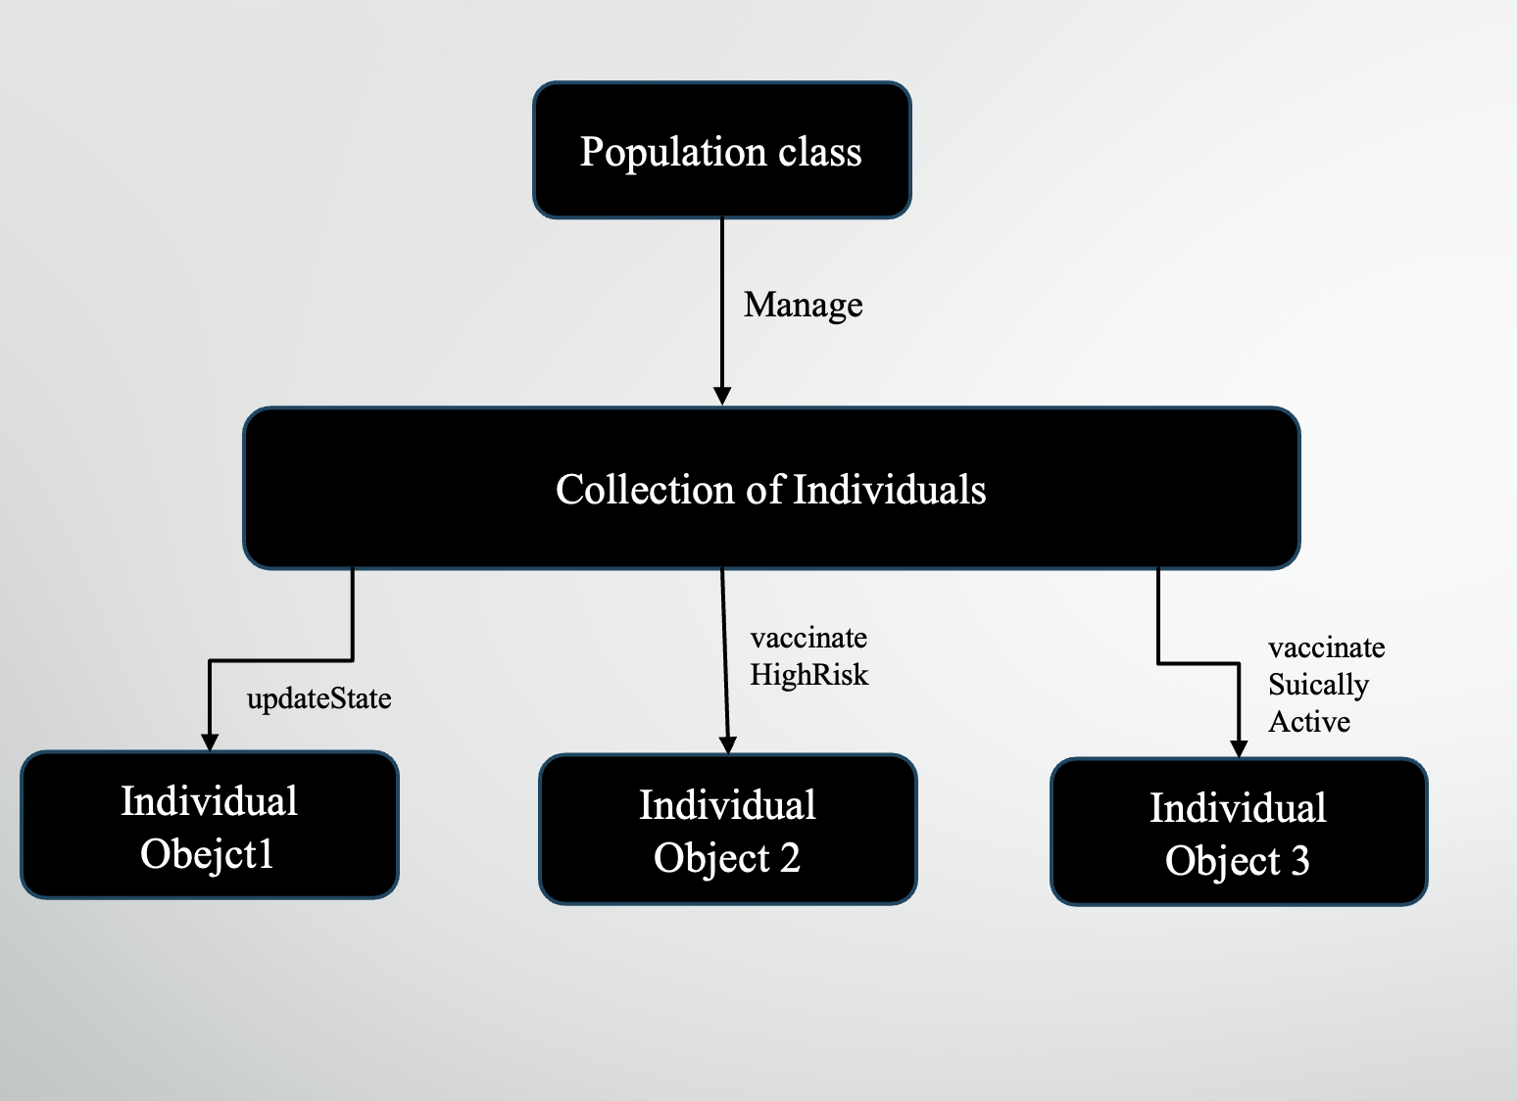
Orchestrating the Simulation – The Population Class Introduction to the Population Class: Represents the entire group of individuals in the simulation. Responsible for managing the collective state and dynamics of the population. Key Responsibilities of the Population Class: Tracks the number and state of individuals (e.g., susceptible, infected, recovered). Simulates interactions among individuals that lead to disease spread or containment. Applies global interventions like vaccinations and monitors their impact.

Slide 11
Key Methods: Population::contagion() Firstly, to ensure the authenticity of the stimulation, the population class includes different regions. The virus starts in a particular region, spreads locally, and there is a small probability of individuals traveling to other regions The virus transmission in a specific region adopts a conservative simulation method: each infected individual's contacts are stored in a set, simulating the transmission among individuals. There is also a small probability for individuals to travel between different regions, thereby causing the virus to spread from one region to another.

Slide 12
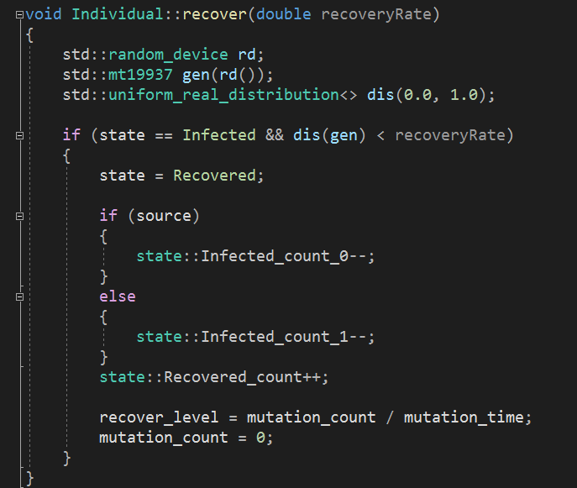
Key Methods: Population::mutation() After multiple transmissions of the virus, it mutates, resulting in individuals who previously had some immunity being directly infected. However, individuals who have been vaccinated will be immune to all strains of the virus. To achieve this, we need to continuously update the number of transmissions during the infection process, and calculate the immunity level during the recovery.

Slide 13
Key Methods: Population::OutPutPopulationStates() To make the output more effective, it's necessary to calculate the number of individuals in each state during every instance of infection, recovery, or travel. In addition, because various situations span across both the 'individual' and 'population' classes, I have placed these counting variables within the 'state' class. I have transformed the variables into 'static' and used two classes to inherit, employing 'assert' to continuously monitor the accuracy of the data.

Slide 14
Some details: Due to some constant variables within 'individual', when copying an individual, I need to redefine the '=' symbol. When simulating the interaction between individuals, there's a need to delete data from vectors at certain times. To avoid the O(n) time complexity, I consistently maintain the index of the data and store it. I use 'assert' to ensure correctness every time.

Slide 15
Learned: Remember, modifying a vector while iterating over it can be problematic in C++, and using index-based iteration in this scenario helps to sidestep that problem.

Slide 16
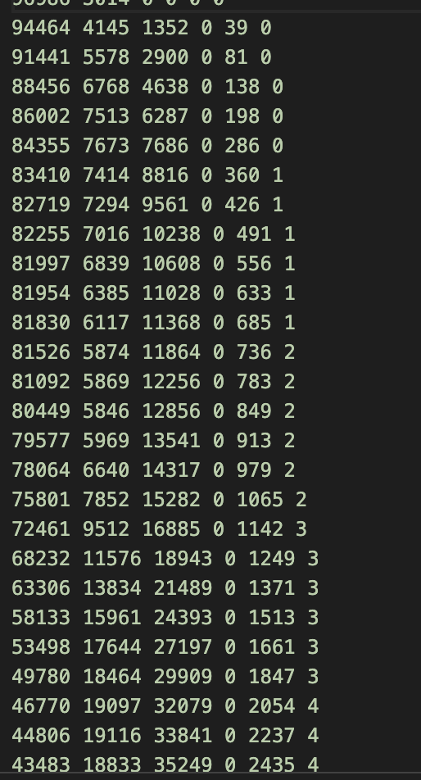
Output Data Analysis Structure of Result.m: The result.m file records the state of the simulation at each time step. Typical structure includes: Days: Marks the specific days in the simulation. Susceptible Count: Number of individuals not yet infected. Infected Count: Number of currently infected individuals. Recovered Count: Individuals who have recovered from the infection. Vaccinated Count: (If applicable) Number of vaccinated individuals. Dead Count: Total fatalities due to the disease.
Output-

Slide 17
Output Visualization Overview: This part of the presentation focuses on how the simulation output is visualized. Using Python libraries: numpy, matplotlib.pyplot, and pandas for data handling and visualization. Interactive visualization using ipywidgets. Visualization Script Features: Data Reading: The script uses pandas to read the result.m file, which contains the time step data of the population. Interactive Plotting: With matplotlib, the script creates bar charts showing the count of Susceptible, Infected, Recovered, Vaccinated, Dead, and New Infections at each time step. Interactivity: Using ipywidgets, the script allows users to adjust a slider to view data for different time steps.

Slide 18
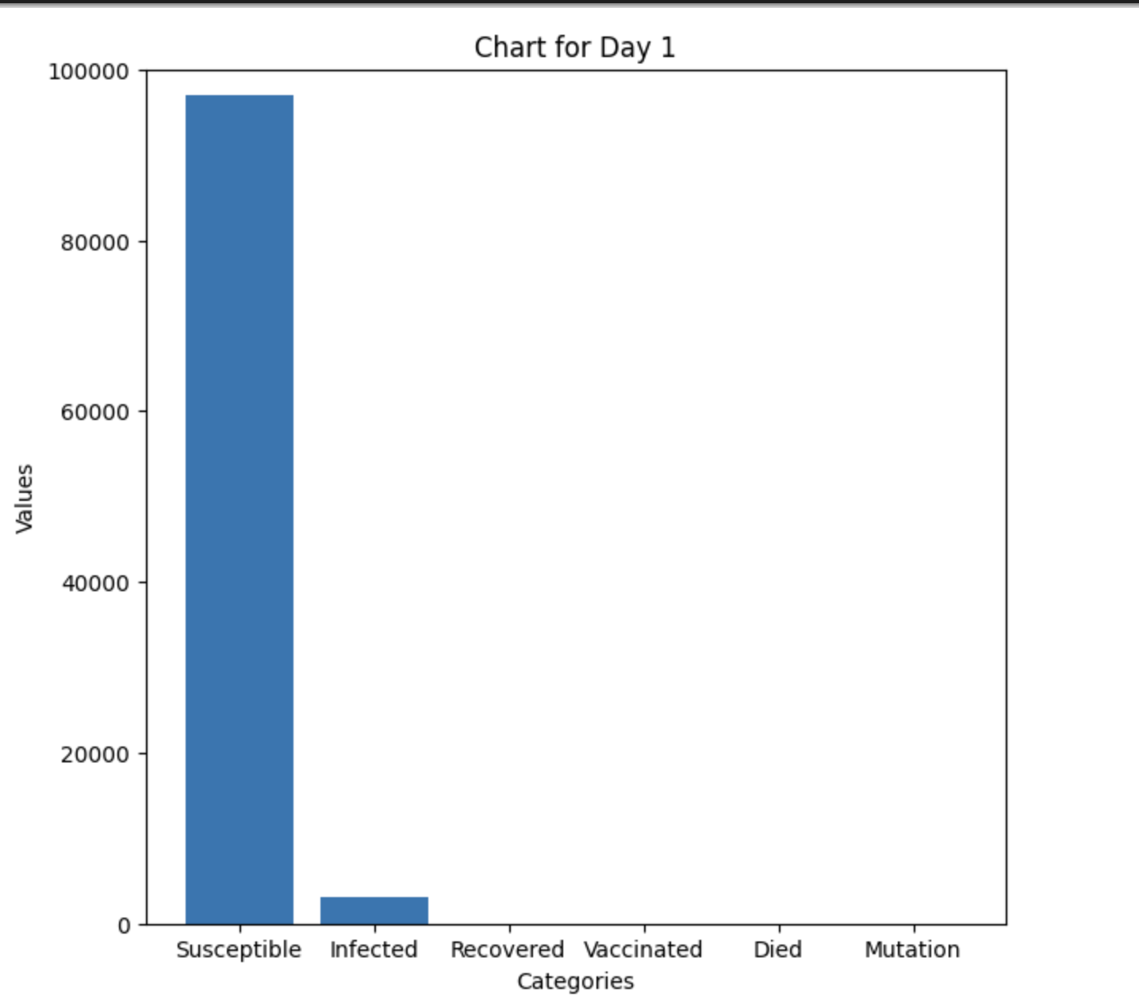
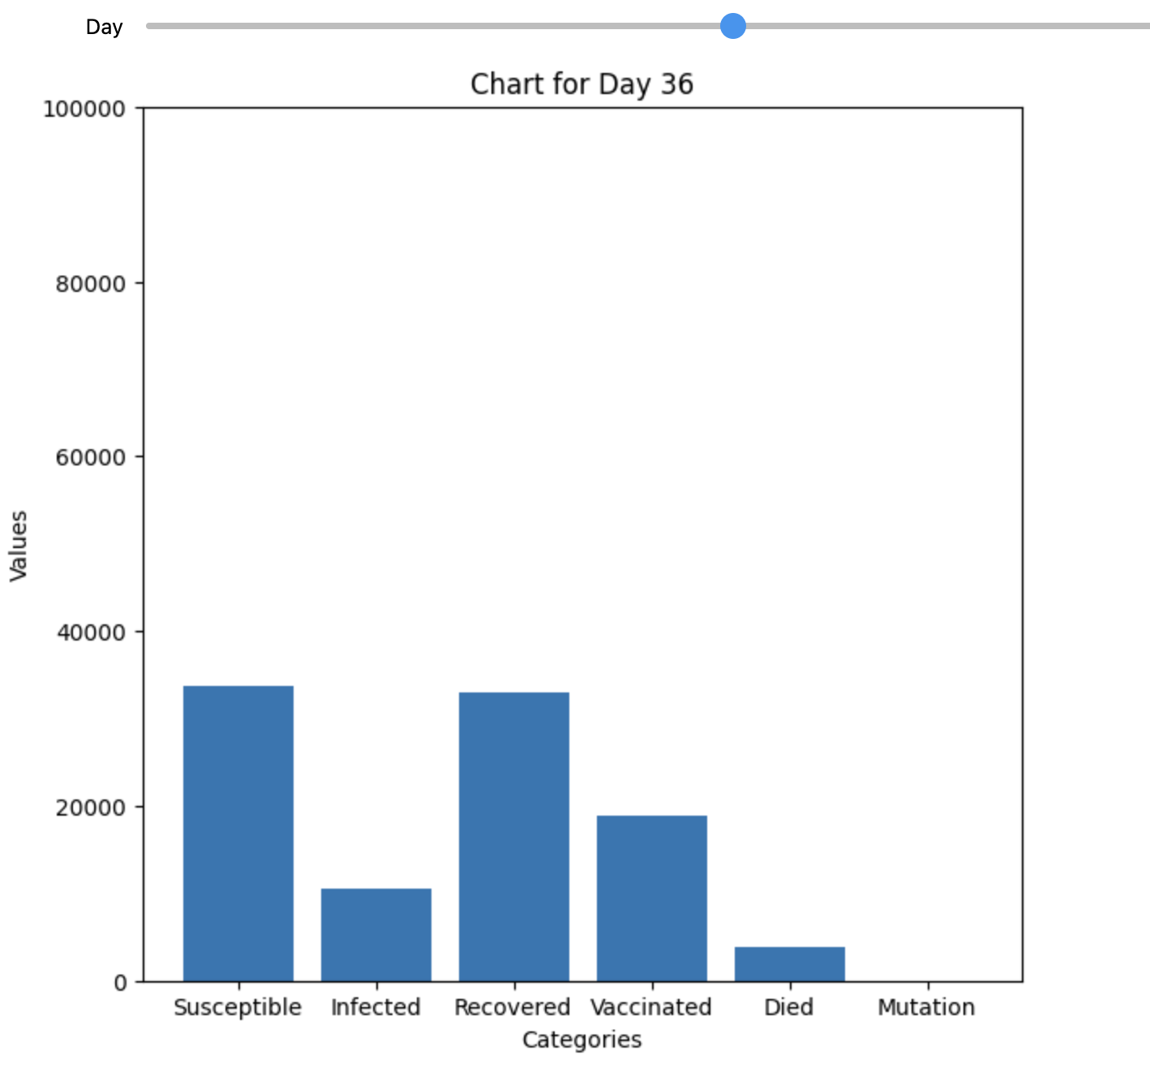
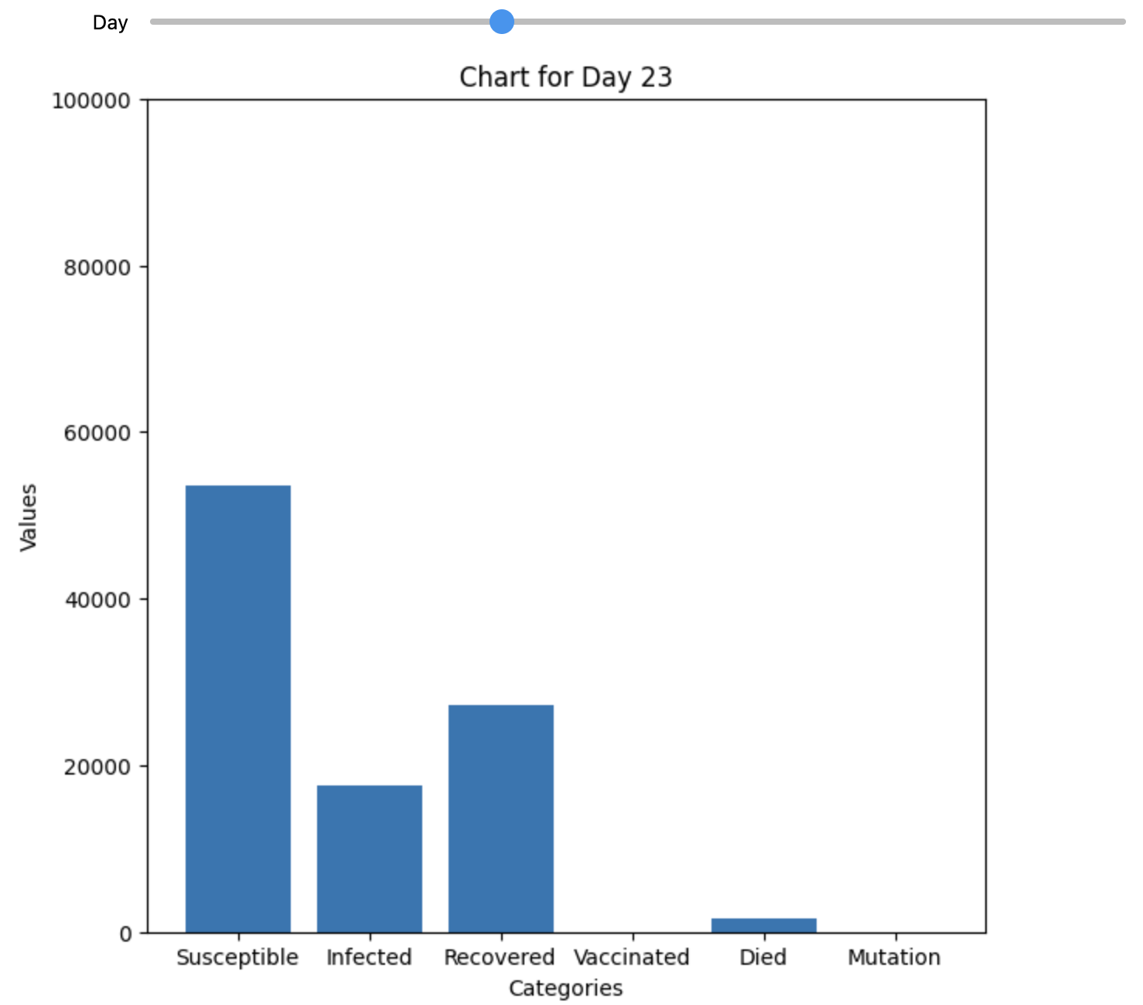
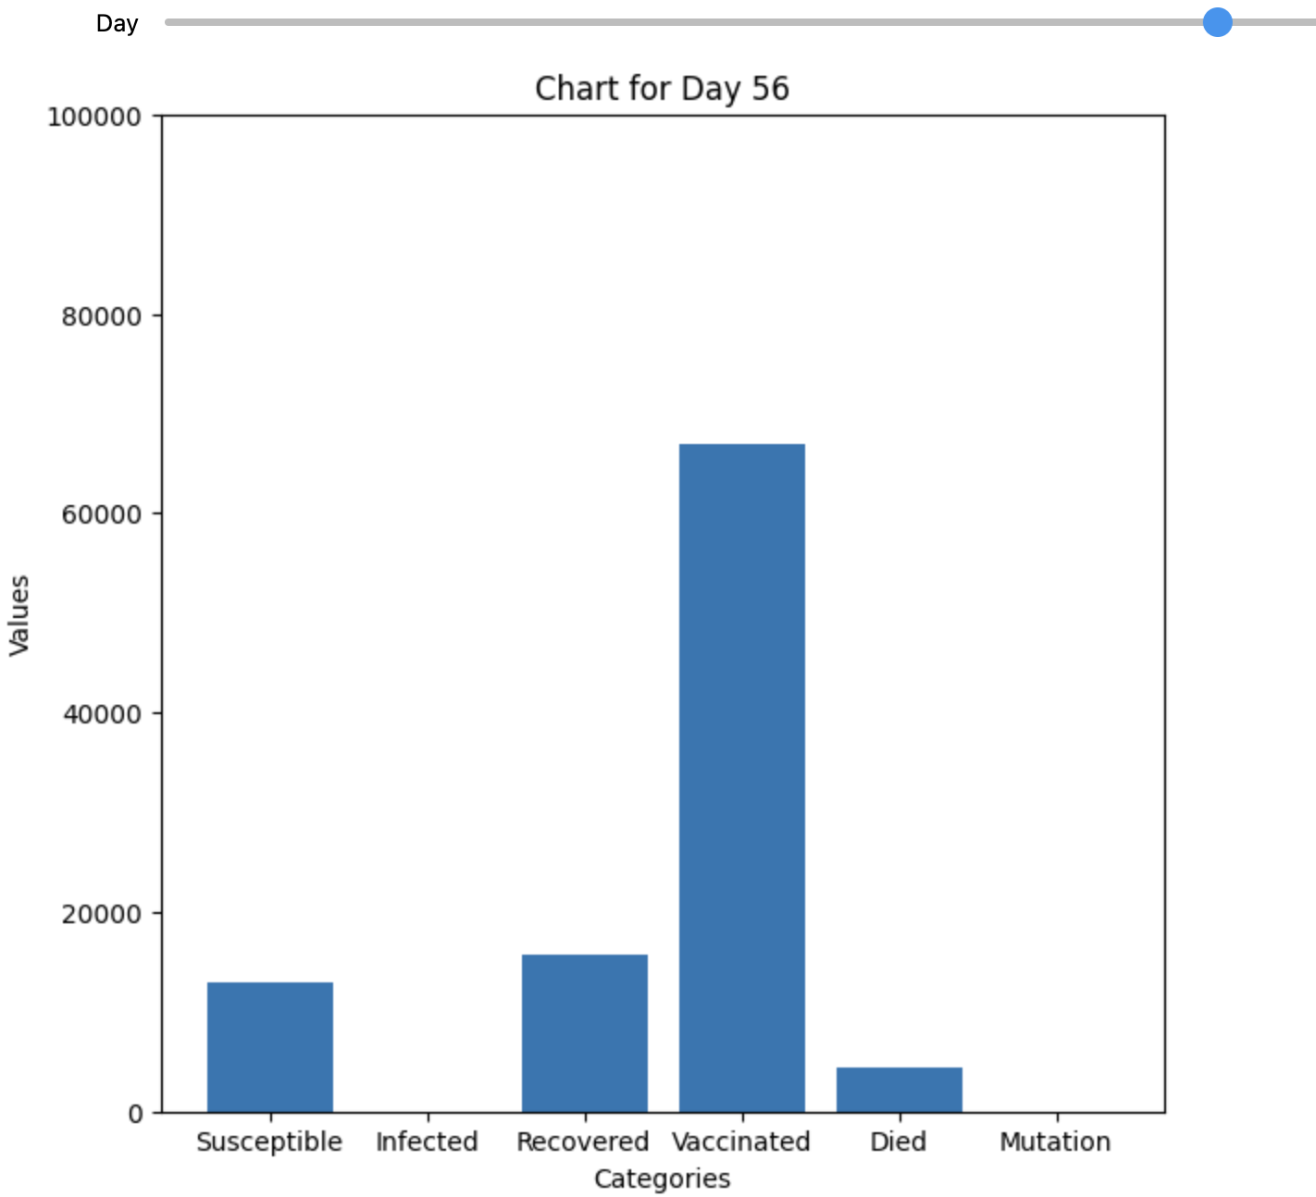

Slide 19
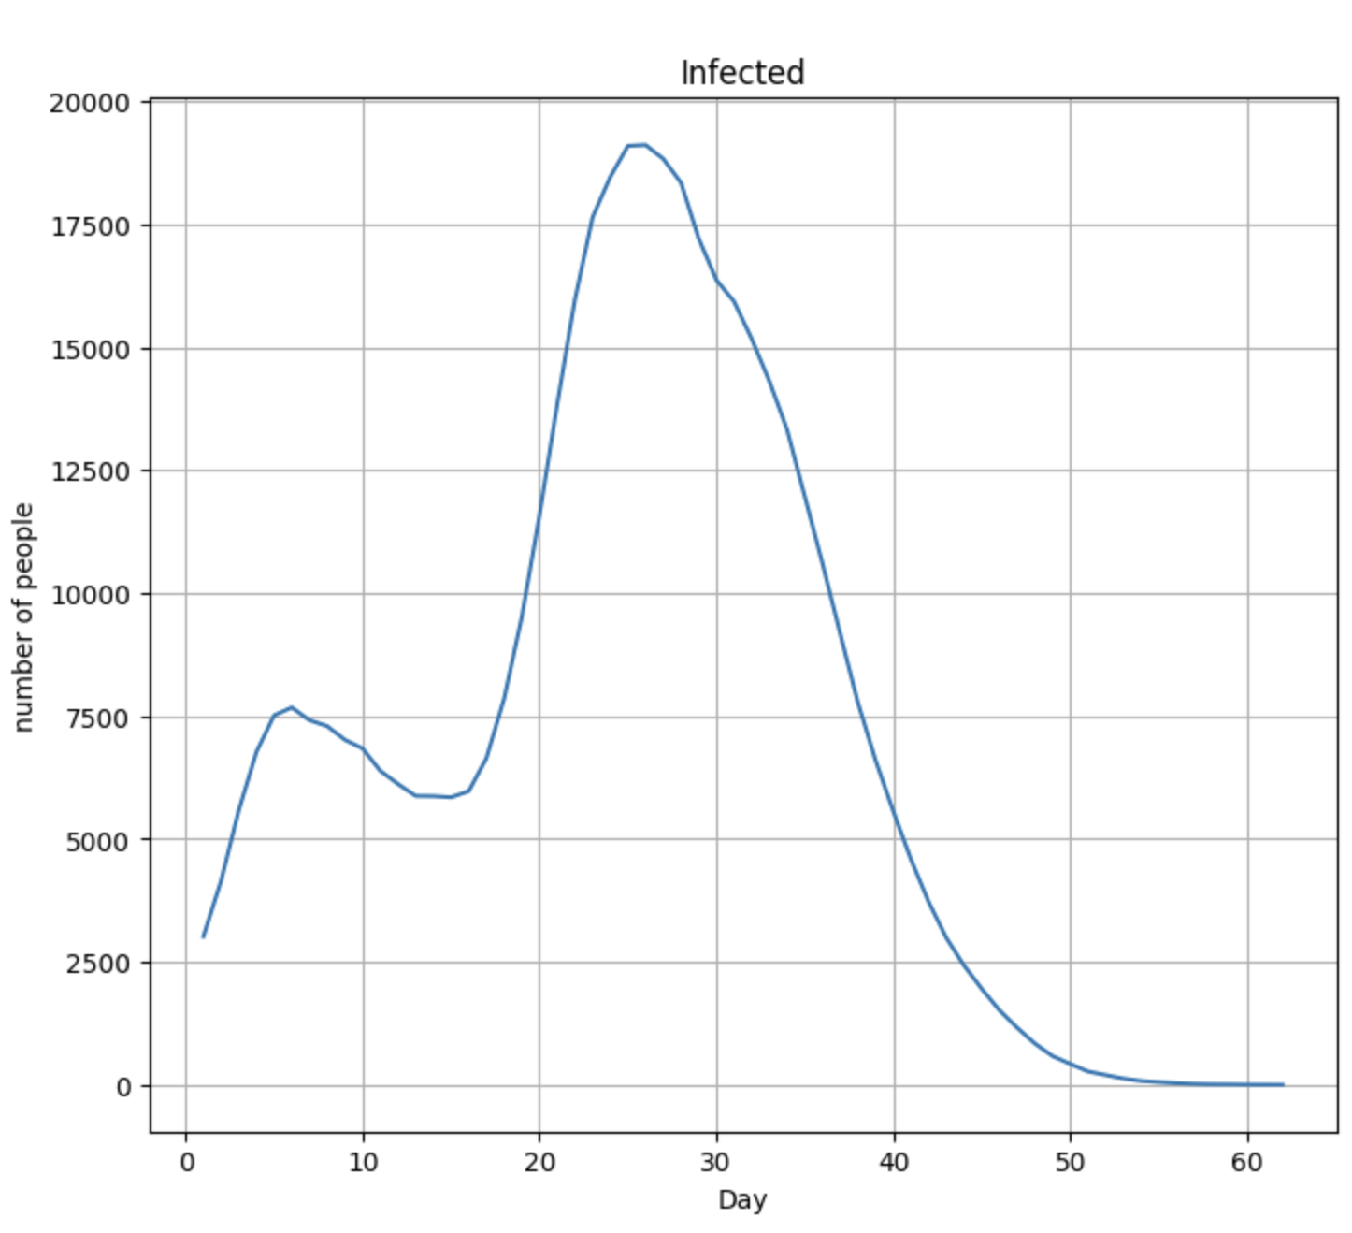
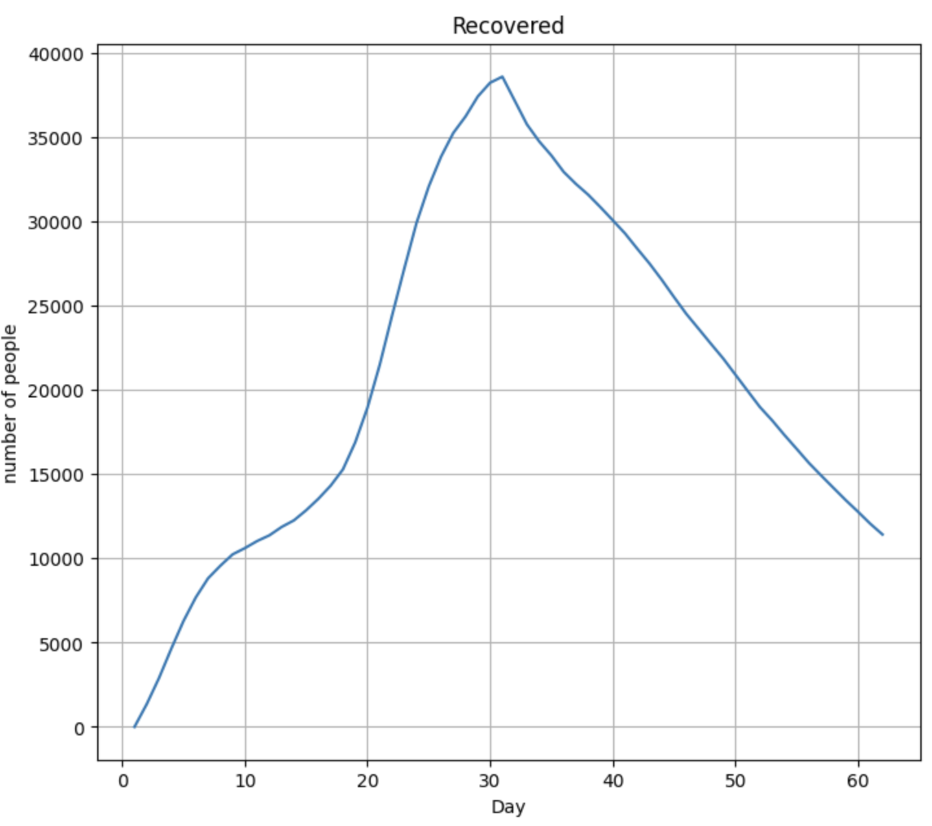
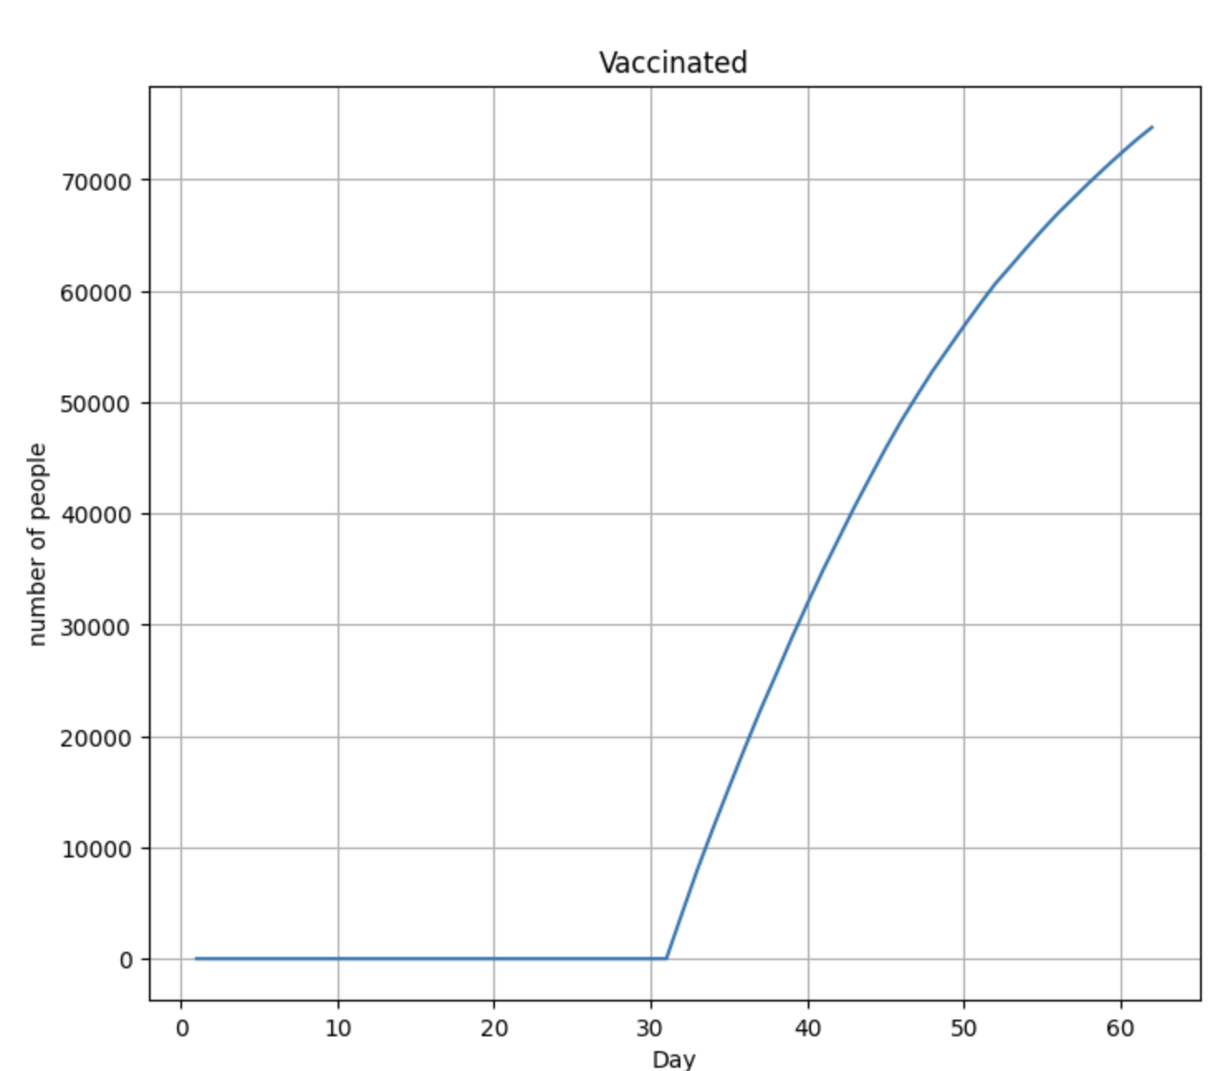
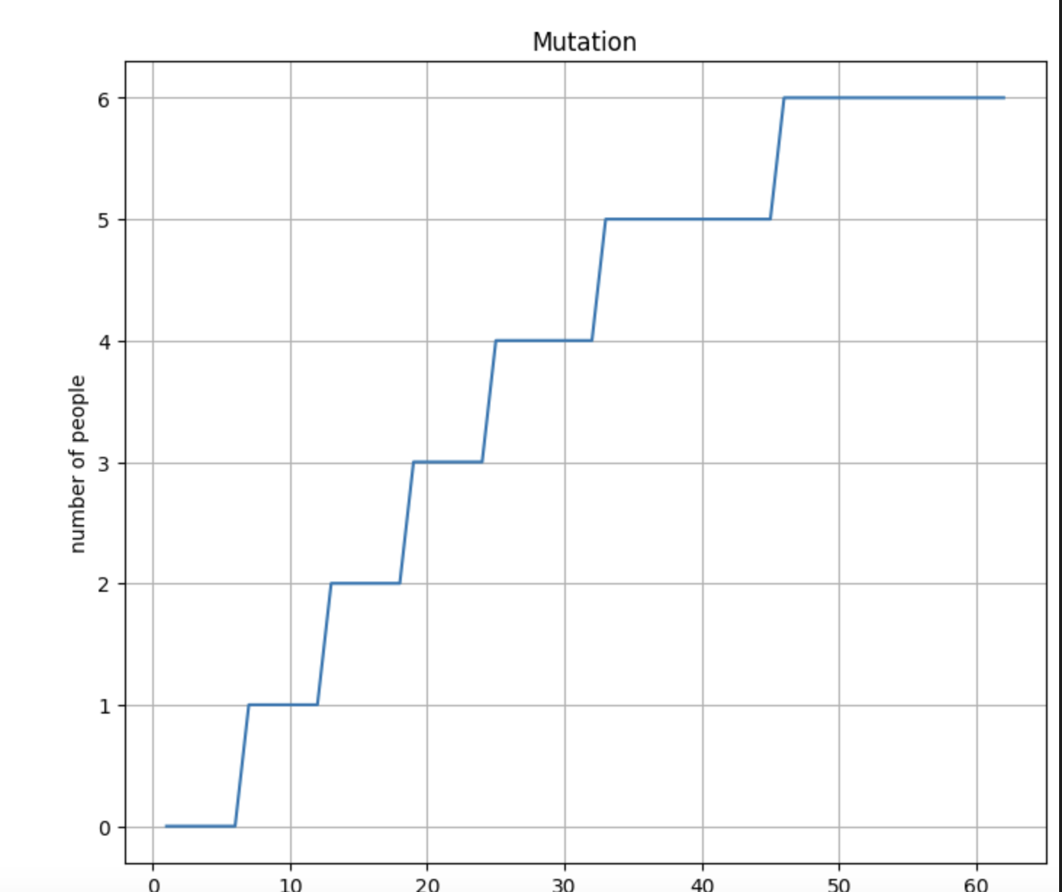
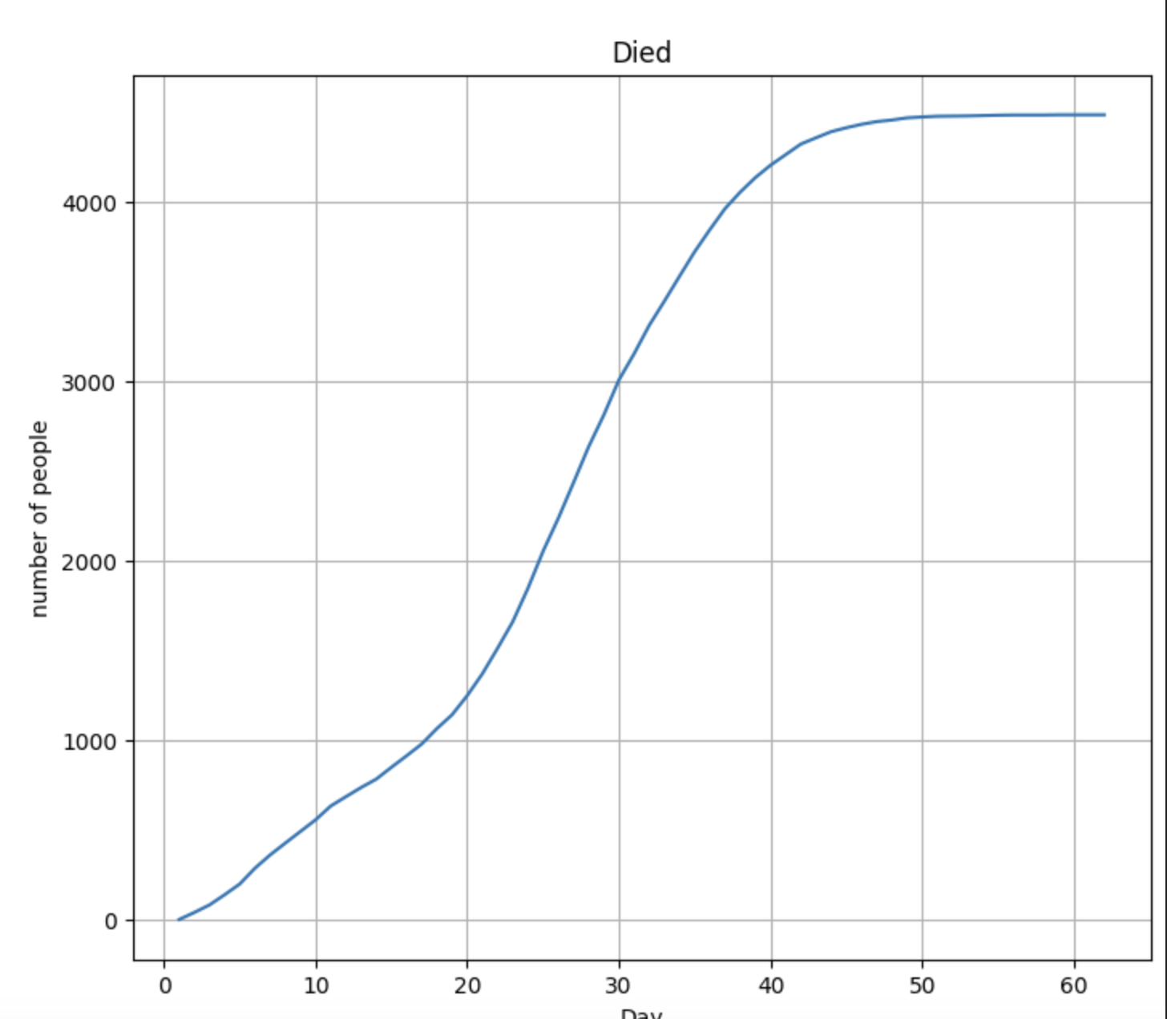

Slide 20
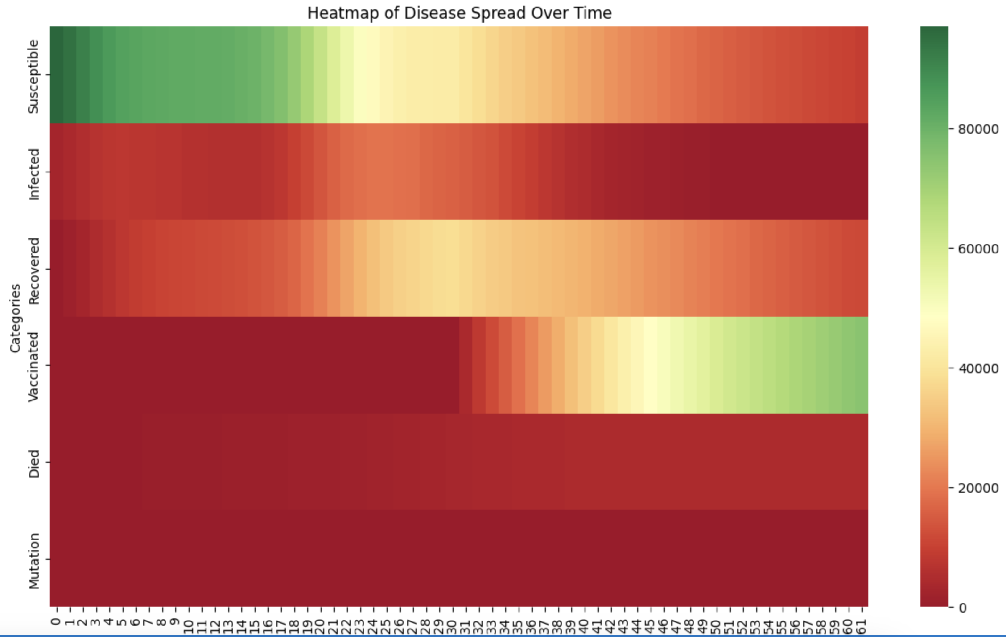
Heat map-

Slide 21
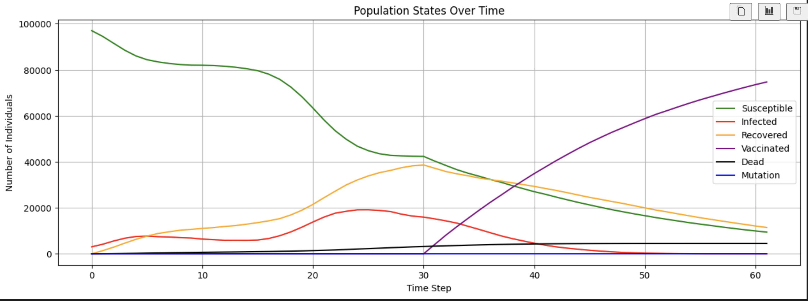

Slide 22
Conclusion: This simulation serves as a powerful tool in understanding the complexities of disease spread. Its significance lies not only in its ability to model current scenarios but also in its potential to predict and plan for future outbreaks. The insights gained can guide public health policies and emergency response strategies, making it an invaluable asset in global health management. Future iterations of the simulation could incorporate more complex dynamics, explore different disease models, or adapt to emerging epidemiological data, continually enhancing its applicability and accuracy.

Slide 23
Thank you!

